Slide 1
Welcome!
Electrical/Firmware Training Week 1
Notes:
Can you see this text? Good, keep this pane open as you move through the slides. We will speak more than we show, so this pane will highlight some points that are important enough to say out loud, but perhaps not important enough to include on the slide.

Slide 2
Last Week!
Introductions
What is RoboJackets Electrical/Firmware?
Logistics
Electrical Basics
Notes:
To catch people up to speed with what was discussed last week, briefly go over some of these points

Slide 3
This Week!
Microcontrollers
Why Firmware?
C++, Part 1
Variables in C++
Arithmetic & Making Comparisons
If / Else
Prototyping
Notes:
Hopefully by the end of this lecture and lab, new members will be able to choose between hardware and firmware

Slide 4
Microcontrollers
aka MCU

Slide 5
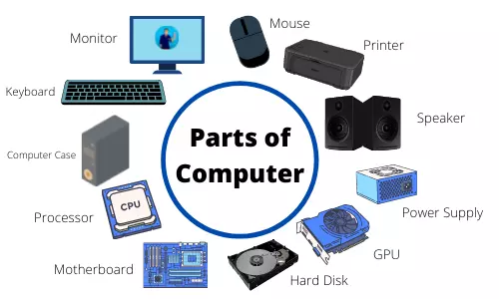
What is a Computer?
Notes:
Everyone knows what’s in a computer
Laptop computer: motherboard, CPU, RAM, SSD/HDD, mouse, keyboard
Put an operating system on the hard disk
Operating system: a special program that allows you to launch other programs

Slide 6
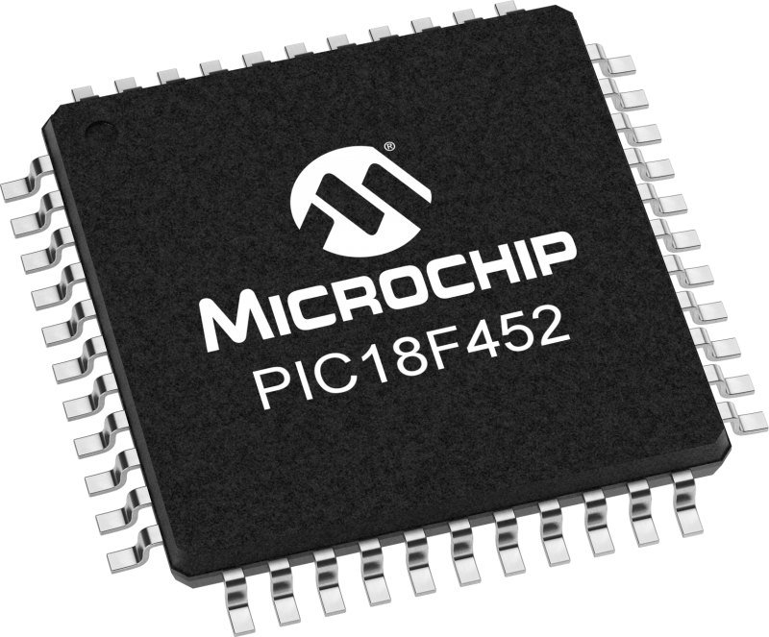
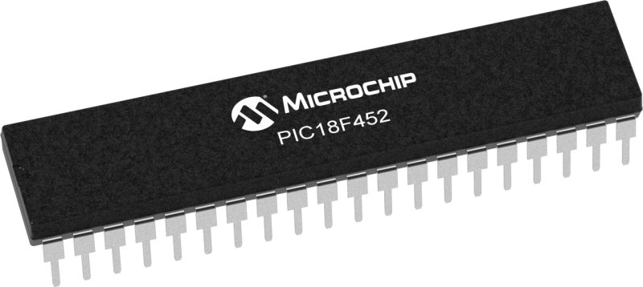
What is a Microcontroller (MCU)?
Website: https://www.microchip.com/en-us/product/PIC18F452#
Datasheet: https://ww1.microchip.com/downloads/aemDocuments/documents/MCU08/ProductDocuments/DataSheets/39564c.pdf
Notes:
These are microcontrollers!
First thing to notice is the package
These are the same microcontroller, just in a different package
Left: DIP (Dual In Line Package), great for prototyping, leads fit into a breadboard
Right: TQFP (Thin Quad Flat Pack), used on a PCB (printed circuit board)
There are even smaller packages out there!
TQFP is considered big, since leads are sticking out. Sometimes, leads are under the MCU to save space
A microcontroller (MCU) is a computer on a single chip
Sometimes called “System on a Chip” (SoC)
Website: https://www.microchip.com/en-us/product/PIC18F452
(click on datasheet)
Has a CPU (like a normal computer)
Has Memory / Storage
Program Memory (Flash)
Data RAM
Data EEPROM (Electrically Erasable Programmable Read-Only Memory)
Similar function to RAM / Hard disk or SSD

Slide 7
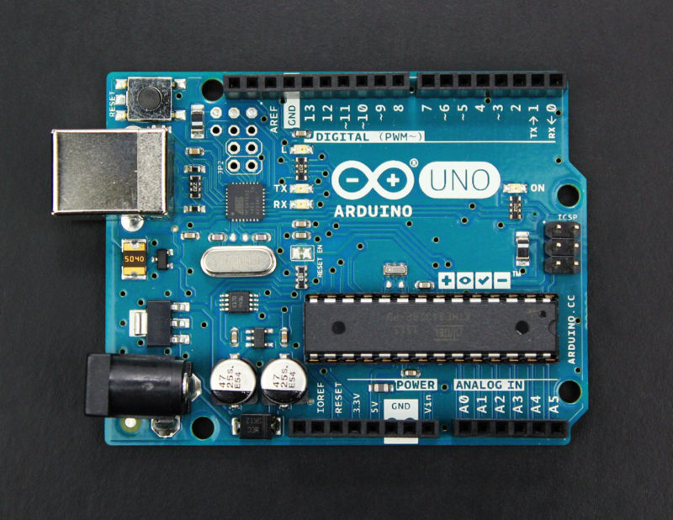
Notes:
Question: where is the actual microcontroller that you program on the Arduino?

Slide 8
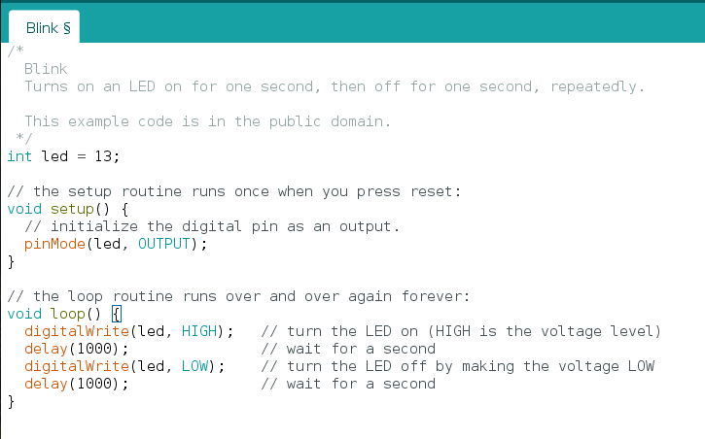
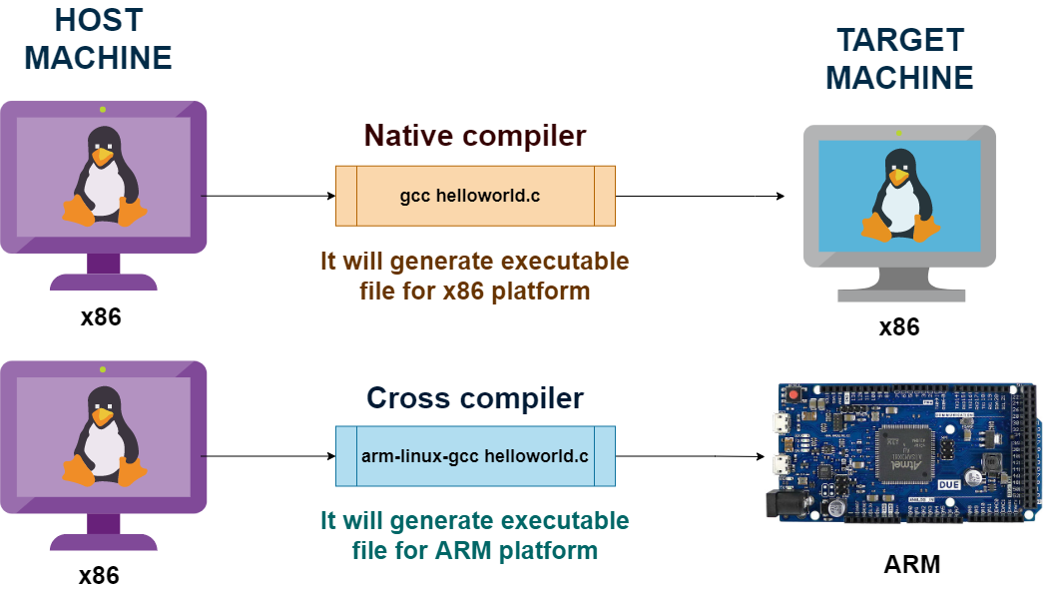
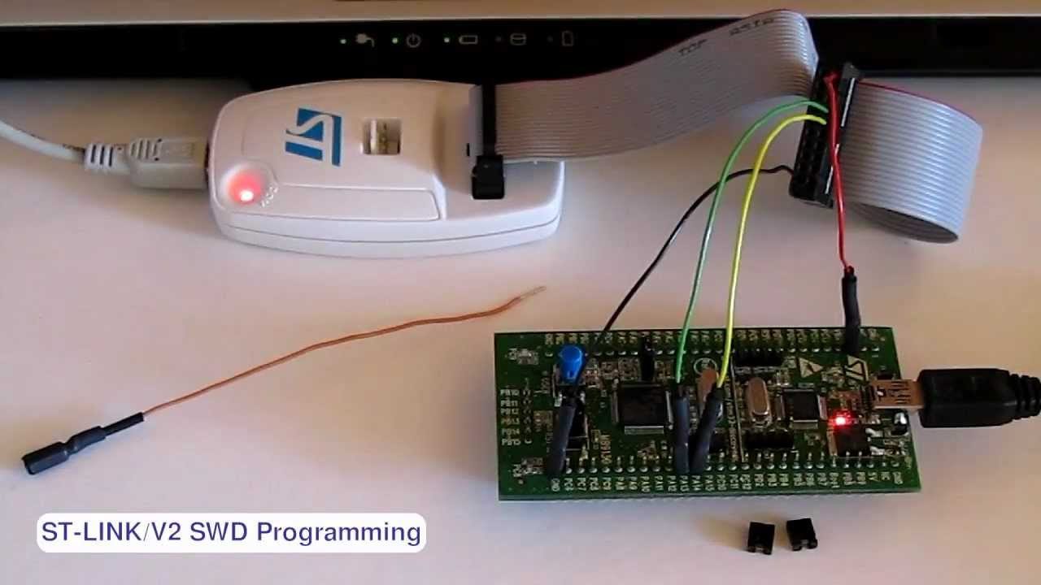
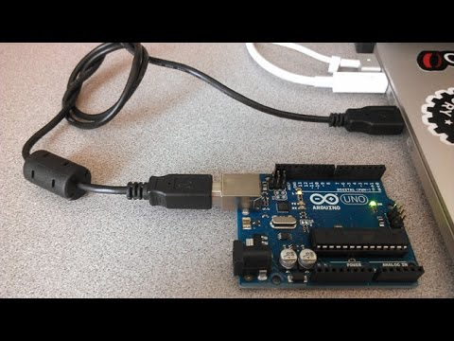
Programming a MCU
Notes:
How it works:
Write a program on your computer
Compile the program for your target platform (called: cross-compiling)
Normally when you compile a program (using gcc or whatever), it will compile the program to run on you computer
However, you want the program to run on the microcontroller. Therefore, you have to change the compiler so it targets a different architecture
If you work in an IDE, this will be done for you if you specify your microcontroller
Upload the code from your computer to the microcontroller
Sometimes, you can just plug the microcontroller into your computer via USB.
Other times, you need a separate device called a programmer (e.g. ST Link, PICkit)
QUESTIONS?

Slide 9
Why do we need firmware?

Slide 10
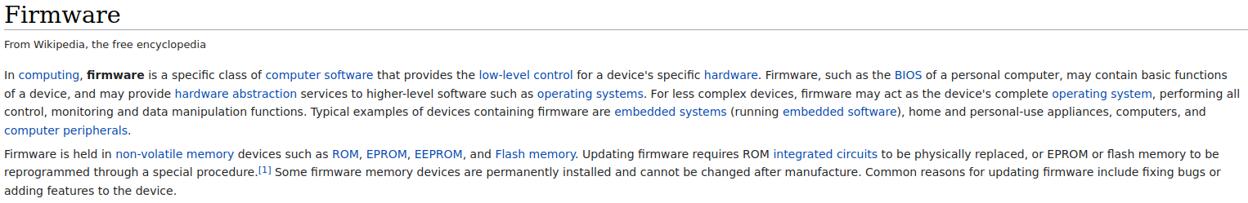

Slide 11
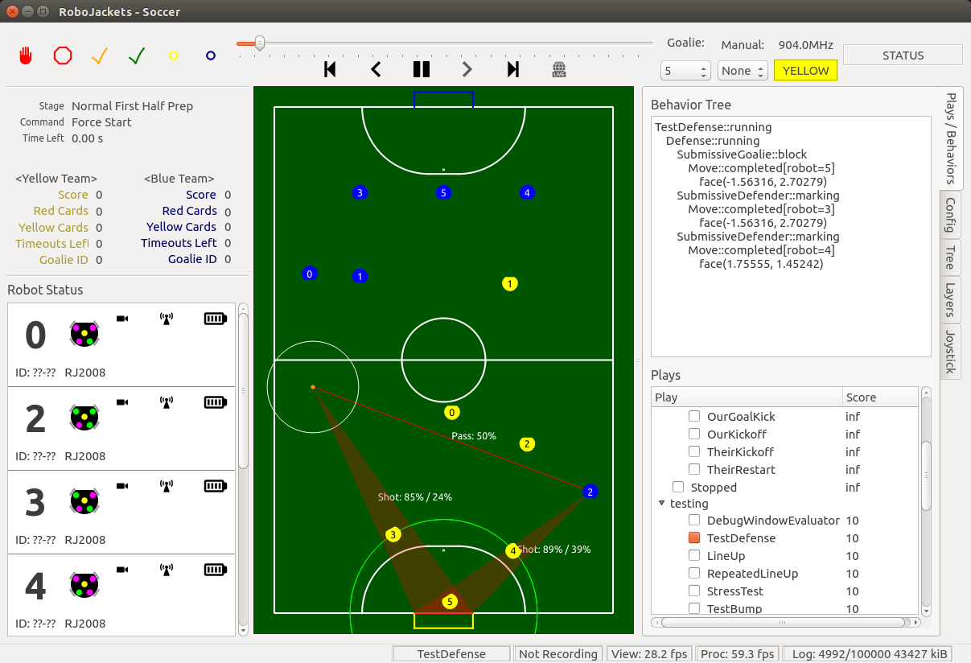
Example: RoboCup

Slide 12
High-level Decisions
Where am I in the world?
Where are my teammates / opponents / goals?
Where should I move?
If I have the ball, when and where should I kick it and how hard?
Low-level Decisions
How do I instruct the motors to spin at the desired speed?
How do I instruct the kicker to kick at a certain time, in a certain direction, with the desired intensity?

Slide 13
Why aren’t Low-level decisions made by a “software computer?”
Speed
Counting encoder ticks <<< Computer vision algorithm
Space
MCUs are small, PCs are not
Overkill
Some robots don’t need to make complicated decisions
PC would be $$$ to replace
Convenience
Robotics hardware + software APIs cater to MCUs

Slide 14
What should I choose?
Electrical or Firmware?

Slide 15
Electrical Timeline
1. Circuit Design
Competition requires X
Solution: This motor / sensor / indicator / communication module solves X!
What circuit is needed to support the solution?
Circuit schematic!

Slide 16
Electrical Timeline
1. Circuit Design
2. PCB Design (KiCad)
Circuit Schematic → PCB

Slide 17
Electrical Timeline
1. Circuit Design
2. PCB Design (KiCad)
3. Physical Electrical Work
Crimping
Soldering
Cutting
Heat Shrinking
Making replacement parts

Slide 18
Firmware
What are inputs / outputs to MCU?
What peripherals does my MCU need to send / receive data?
Do I need to transform the data?
Circuit prototyping
How do I program the MCU to handle inputs / outputs?
How does the MCU interact with software?
Notes:
Today, we will be touching on #4 and #5.
#1, #2, and #3 deal with microcontroller peripherals and communication protocols. You will be learning about these in future weeks.
However, a large part of these points are application specific. You will learn these things by joining a team and learning by doing.
Firmware is challenging but rewarding; you will learn a lot about digital electronics, computer hardware and software, and low-level programming.

Slide 19

Intro to C++
C is more readable assembly…
C++ is an object-oriented hack of C.
– imprecise quotation of Jim Rehg
A programming language
https://github.com/RoboJackets/firmware-training
Go to “Binder Link” at bottom of page!

Slide 20
C++ Variables & Types
//set up and
//assign a
//value like below
int i = 5;
//you can also set
//up a variable
//without initially
//assigning a value
bool rain;
rain = false;
int → integers (e.g. 12, -17)
double → floating point or decimal
numbers (e.g. 1.23)
char → single characters (e.g. “s”, “D”)
string → text (e.g. “Hello world”)
bool → logical values (e.g. true/false)
Notes:
We need to declare a variable before assigning a value to it. Also, we do not have to assign a value immediately after creating a variable, but we MUST declare what the variable type is. If you try assigning a value to variable of the incorrect type, you will get a value error.
Mention that ONE = is assigning variables.

Slide 21
C++ Arithmetic Operators
+ → Addition
- → Subtraction
* → Multiplication
/ → Division
% → Modulo (produces the remainder e.g. 9 % 4 >> 1)
Notes:
Stella
For Division:
If both operations are integers, the result will be an integer. If one or both operations are floating-point values (aka decimal numbers), the fractional part is kept so the result will be a floating-point number. Value will be truncated, and not be rounded.

Slide 22
C++ Relational Operations
== → Equal to
!= → Not equal to
> → Greater than
< → Less than
>= → Greater than or equal to
<= → Less than or equal to
Notes:
Output gives boolean values
Explain equal to == in sample code
Comparing two value
Writing conditions or doing a loop

Slide 23
C++ Conditions
*assigning variable*
If the condition (within brackets) in the if statement is true, then the code within the first set of braces will execute and will output “Three!”.
Else if statements can be added in between if and else to provide additional conditions
int num = 4;
if (num == 3){
return “Three!”;
} else if (num == 5) {
return ”Five!”;
}
*is equal to*
Notice the braces
Notice the indentation
Notes:
Devaughn
If the condition is met, the other conditions are skipped. The next slide will talk about the else block. You could talk about how you could else for all other conditions

Slide 24
C++ Conditions
*assigning variable*
The else statement will execute when all previous conditions evaluate false
Note that once a condition is met, no further code within the if block will execute
int num = 4;
if (num == 3){
return “Three!”;
} else if (num == 5) {
return ”Five!”;
} else {
return num;
}
*is equal to*
Notice the braces
Notice the indentation
Notes:
Devaughn
Last slide of C++. Ask for doubts if time permits

Slide 25
Prototyping
Breadboard and Arduino Uno
Notes:
Stella
A prototype is like your first draft of an essay; it does not need to look nice or work perfectly. It is important however to understand the purpose and working of your prototype. For this reason, it may be worth recording your change between each iteration of your prototype.

Slide 26
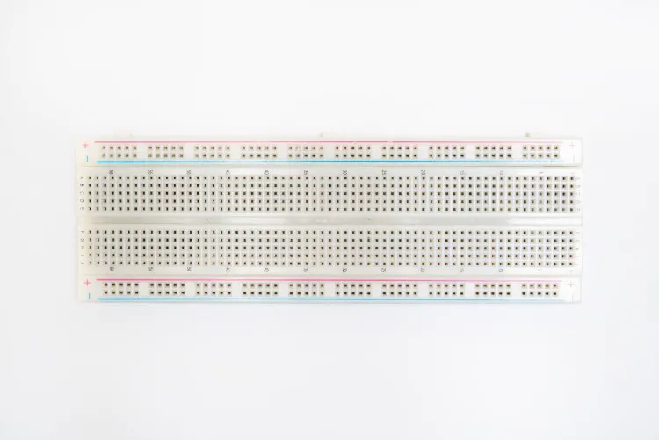

Breadboards
Prototype basic circuit designs with
Breadboards help you connect electrical components to build basic circuits.
Terminals are the vertical columns. Each terminal is independent from the other
Power rails are use to connect the power supply to the breadboard. The horizontal pins on each power rail are connected.
Top half and bottom half of the breadboard are independent from each other.
Connection
No connection
Notes:
Called power rails since they are mostly used to connect the power supply to the breadboard. The next slide shows an example of a breadboard connection

Slide 27
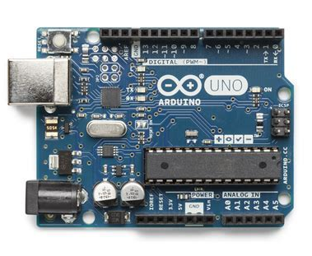
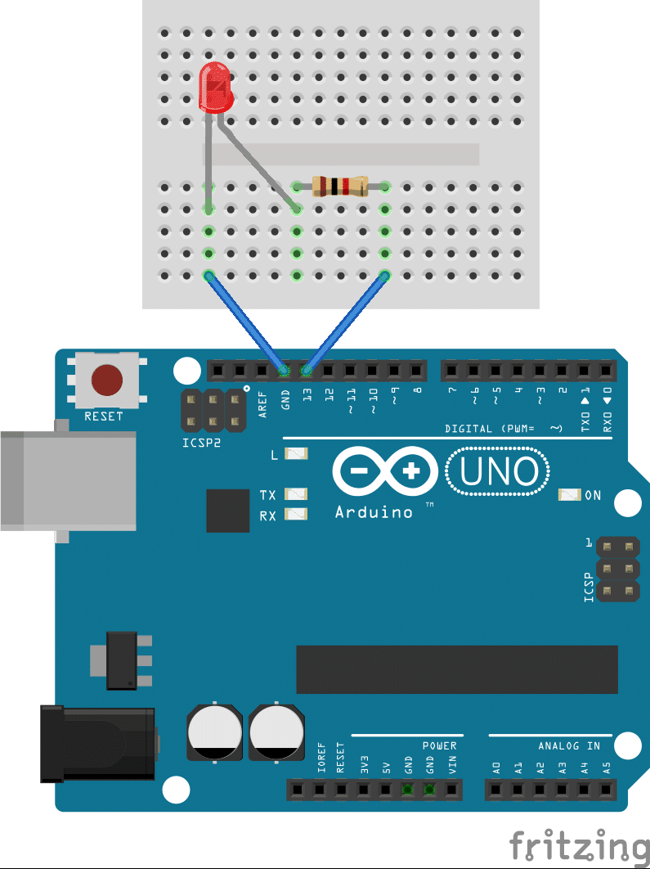
Arduino Uno
Microcontroller with I/O ports to control electronics
Notes:
One of the easiest platforms to learn about microcontrollers. We can connect electrical components to the Uno to create a circuit (hardware) and then program the uno using Arduino IDE (firmware).

Slide 28
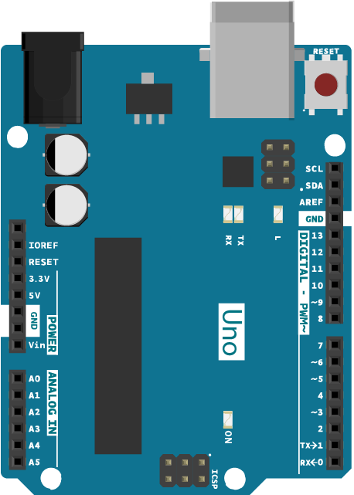
Arduino Board Explained
Power: an Arduino can be powered using a USB cable or a Barrel Jack. Use between 6V and 12V
GND can connect components to Ground
5V & 3.3V: supplies power to components
ANALOG IN: A0 - A5 pins can read values from analog sensors
DIGITAL pins cans be used as input from components (like switches) or output to components (like LEDs)
PWM: some pins have a tilde (~) symbol next to it for Pulse Width Modulation (PWM) to simulate analog output.
Notes:
Devaughn
The hardware of Arduino. Hover over each pin with pointer
These are the Arduino’s hardware peripherals. This is how the Arduino interacts with the outside world. (a similar function to a computer monitor, a camera, a keyboard and mouse)

Slide 29
Arduino Board Explained
AREF: used to set external reference voltage between 0V and 5V for analog input. You would mostly ignore this.
RESET (button): temporarily connects reset pin to ground to restart code. Useful when you cannot reset with a computer.
Built-in LED: a mounted LED that can be programmed to blink.
Notes:
Devaughn
AREF helps with accuracy

Slide 30
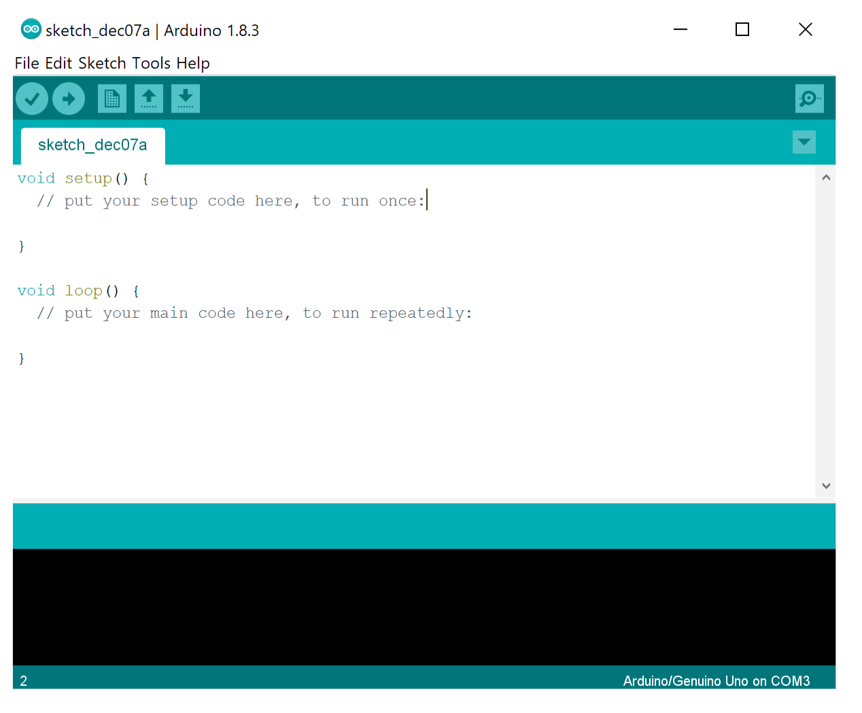
Arduino IDE Explained
IDE aka integrated development environment
Programs written using Arduino Software (IDE) are called sketches.
Verify checks for errors and compiles code
Upload compiles and uploads code
New creates new sketch
Save saves your sketch
Serial Monitor displays print outputs
Notes:
Devaughn
Firmware part of Arduino. Used to write and upload code to the board. More about functions will be spoken of in week 2 of firmware. For now, functions are synonymous for instructions.

Slide 31
Arduino IDE Explained
void setup()
initialize variables and define pins
Runs once
void loop()
write code to read from and write to pins
Runs multiple times
The Arduino IDE has a lot of built-in libraries that boils down complex tasks into simple functions. You can add libraries to your sketch using #include
Sketch > Import Library
The code used in Arduino IDE is very similar to C++
Notes:
Devaughn
Firmware part of Arduino. Used to write and upload code to the board. More about functions will be spoken of in week 2 of firmware. For now, functions are synonymous for instructions.

Slide 32
Common Arduino IDE Functions
pinMode(pin, mode); //goes in void setup()
Configures the specified pin to act as an input or output
digitalWrite(pin, value); //goes in void loop()
Write a high (5V) or low (0V) value to a specified pin
digitalRead(pin); //goes in void loop()
Read a high or low value from a specified pin
Returns true if voltage is HIGH, or false if it is LOW
delay(value); //goes in void loop()
Pauses code execution for a value—time in milliseconds
Notes:
Stella
More about what functions are later. For now, functions are synonymous for instructions
The argument pin takes a number for digital or A0-A5 for analog in
Mode takes INPUT/OUTPUT. Value takes HIGH/LOW
Mention analog versions, there’s more detail about analog mentioned on lab sheet

Slide 33
Common Arduino Functions
analogRead(pin); //goes in void loop()
Returns an analog value from an analog pin
Serial.print(); //goes in void loop()
Used to print values in serial monitor and to see if your code is being executed → Useful for debugging.
Requires Serial.begin(value); in void setup
Notes:
Stella
More about serial print in the lab document

Slide 34
Lab
LEDs and Buttons
Notes:
Explain what is a thermistor/heat sensor

Slide 35
Lab Setup
This week we will build a simple circuit to light up LEDs and we will use an Arduino Nano to control which LEDs light up.

